Slide 1
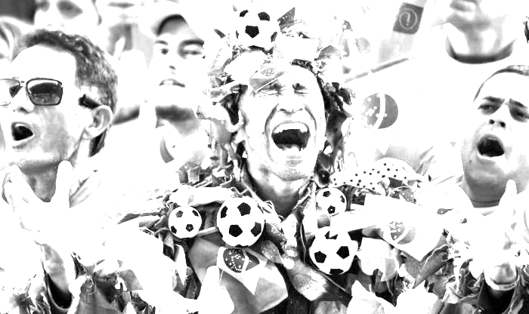
SPORTS HIGHLIGHTER
Roy, Brian and Michael

Slide 2


Slide 3
Survey Results
There appears to be an opportunity to give sports fans more content that takes less time to watch.
Do you have access to more sports footage than you have time to watch each week?
90.3% said yes
Do you ever wish you could get a quick recap of a game without browsing for it?
77.9% said yes
Do you re-watch sports events?
52.3% said yes
How many hours would you watch if you had more time?
32.3% of respondents would watch 9+ hours of footage each week (vs. ~10% who do now)

Slide 4
ROI and Impact
Sizable market and clear thirst for short-form internet content.
1B+ eligible sports fans in the market, worldwide.
We believe almost all sports fans have an insatiable thirst for more content, but don’t have enough time to watch it all.
Rapid growth in the mobile market, especially in BRIC.
Market ripe for great short-form footage to free up more time to watch even more great sports action.
Notes:
Reference for US figures: https://web.holycross.edu/RePEc/spe/HumphreysRuseski_SportsIndustry.pdf

Slide 5
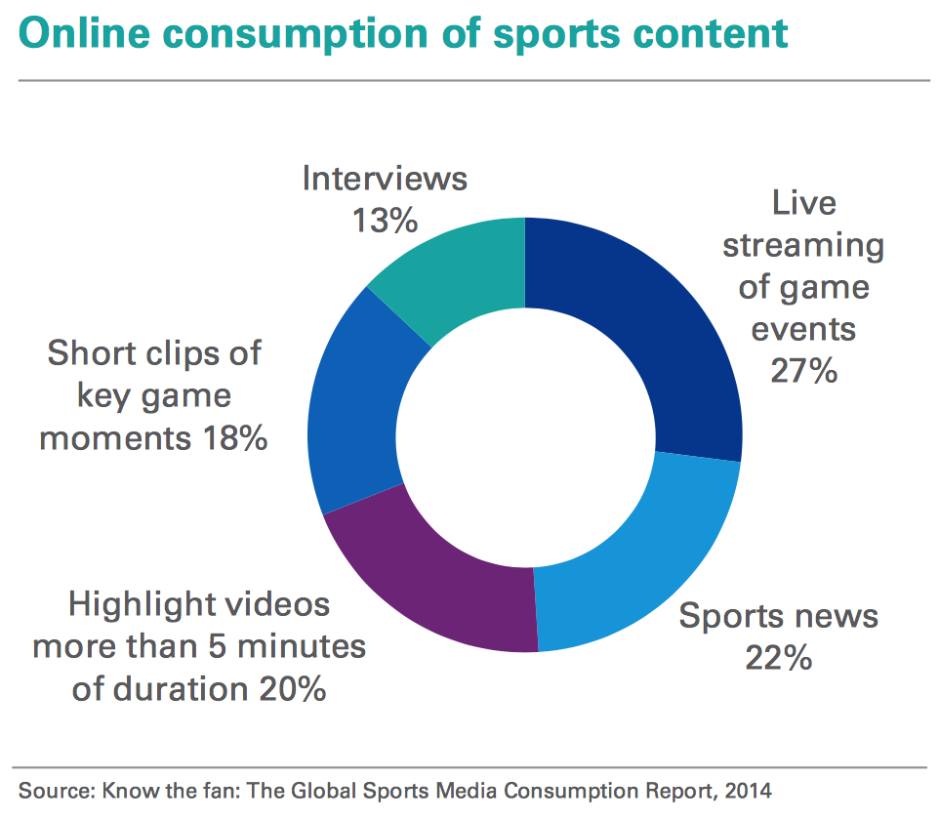
Internet Market Breakdown
There appears to be an opportunity to give sports fans more content that takes less time to watch.
Notes:
https://assets.kpmg.com/content/dam/kpmg/in/pdf/2016/09/the-business-of-sports.pdf
100B+ market that expands into rapidly-growing territories; 1B+ eligible fans across the world

Slide 6
Our Proposed Solution
Short-form content that is created on the fly, for the games you want.

Slide 7
Can’t they already watch highlights?
Expensive to produce manually
Networks choose what highlights to show
Highlights (e.g. SportsCenter) are shows (find, record, scan)

Slide 8
MVP & Key Features
Can we outshine tweets, highlights and other existing forms of short-form content?
An algorithm we can apply to any soccer footage to generate high-quality short-form content.
Live YouTube channel with short-form content generated by us.

Slide 9
How It All Works Now
Utilizing audio data for event detection.
PCA
Training Data
MP4
Magnitude
Prediction
FFT Data
tSNE
KNN
Classifier
Phase
SVD
Actual Footage | Fast Fourier Transform | Dimension Reduction | Classification | Event Detection

Slide 10
The Data Pipeline
Training
Realtime(?)
Video (MP4)
Video (MP4)
FFMPEG
FFMPEG
Detect Chyrons’
Locations
Audio (WAV)
Audio (WAV)
FFT
FFT
Frequencies
Frequencies
Detect Chyrons’
Presence
Assemble
Highlights video
PCA
PCA
Reduced
dimensions
Reduced
dimensions
OCR
Model
Text
Determine clip boundaries
Classifier
Prediction

Slide 11
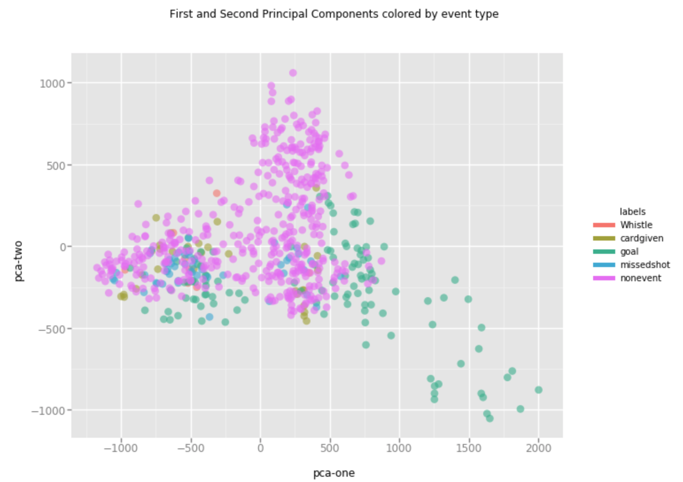
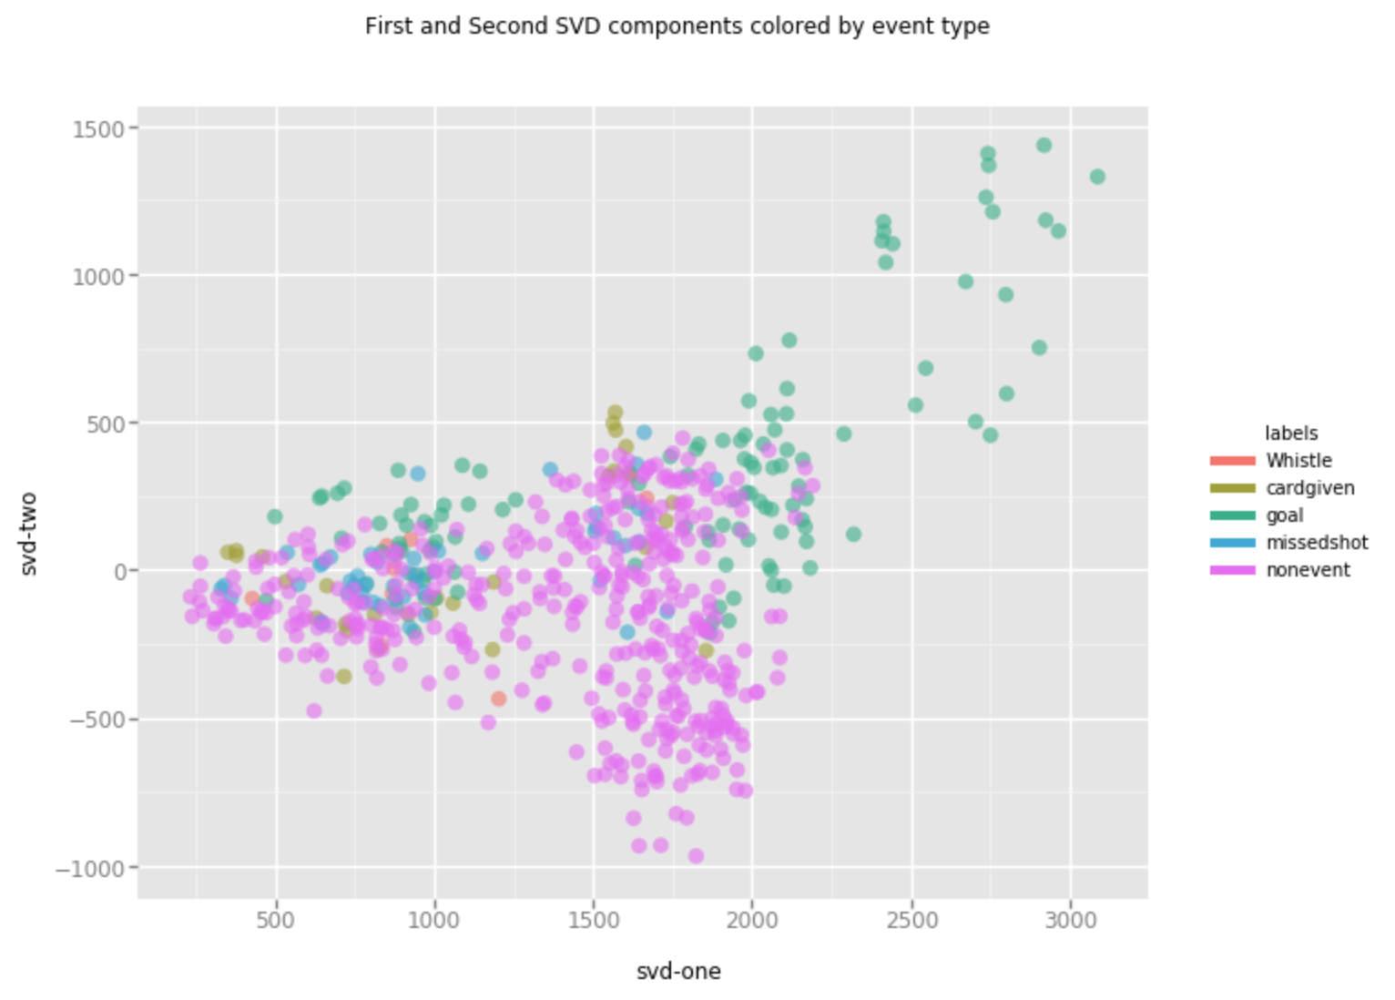
Post-FFT Transformation
SVD, PCA look like reasonable early starting points for our model..

Slide 12
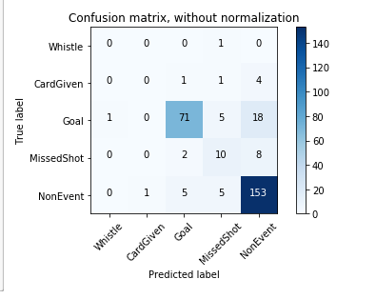
Early KNN Classification
We correctly predicted ~82% of post-goal moments.
Current Results
Accuracy: 81.8%
F1: 80.5%
Precision: 79.5%
Recall: 81.7%

Slide 13
Other Early Classifiers
Gradient Boost Classifier and Random Forest show early promise.
Gradient Boost
Accuracy: 84.2% F1 score: 80.7% Precision: 80.9% Recall: : 82.6%
Random Forest
Accuracy: 83% F1 score: 80.7% Precision: 80.9% Recall: : 82.6%
MLP Classifier
Accuracy: 78.9% F1 score: 80.7% Precision: 80.9% Recall: : 82.6%
Logistic Regression
Accuracy: 78.5% F1 score: 80.7% Precision: 80.9% Recall: : 82.6%

Slide 14
Next Steps
Explore other classifiers
Generate more training data
Perfect or dump chyrons
Final event picking algorithm
Scene boundary detection

Slide 15

Who We Are And Why This Matters
Let’s highlight what’s important so sports fans can enjoy more quality footage in less time.
Time is precious
Too much sports
We don’t read all the newspapers
We don’t read all our friends’ walls
The time has come...

